Slide 1


Lesson 2 Sports heroes
UNIT 2

Slide 2
Solve the riddle. Write riddles for 4 Olympic sports.
ICE HOCKEY
FIGURE SKATING
It’s played indoors, both by men and women. It’s a team sport. Players wear helmets and protective clothing. The one who scores the most goals, wins. Players use a puck and a funny looking sticks.
It’s the most glamorous sport of the Olympics. Competitors dance on ice. They wear beautiful costumes and can perform amazing jumps.

Slide 3
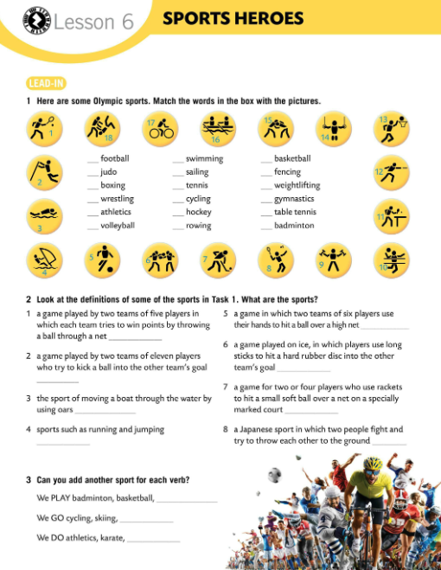
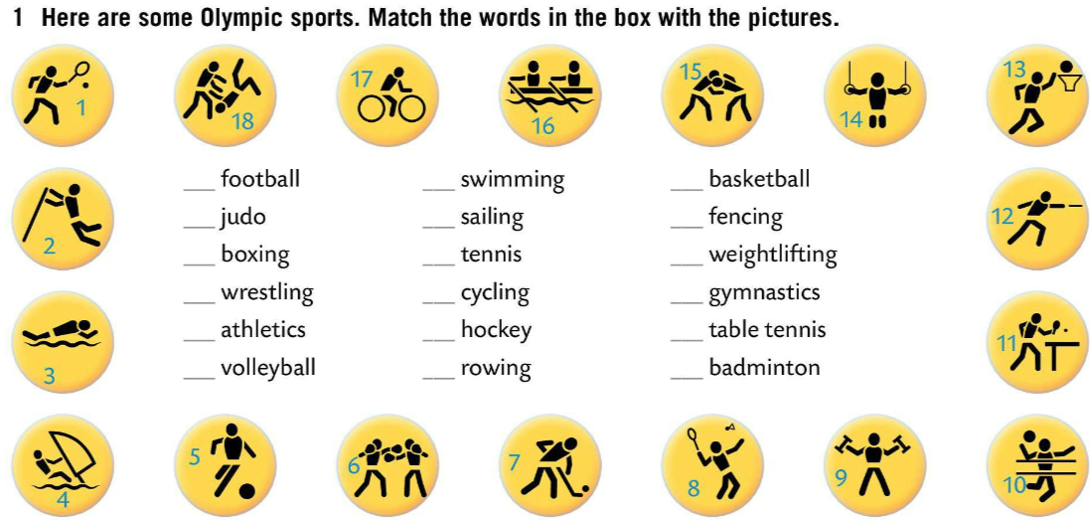
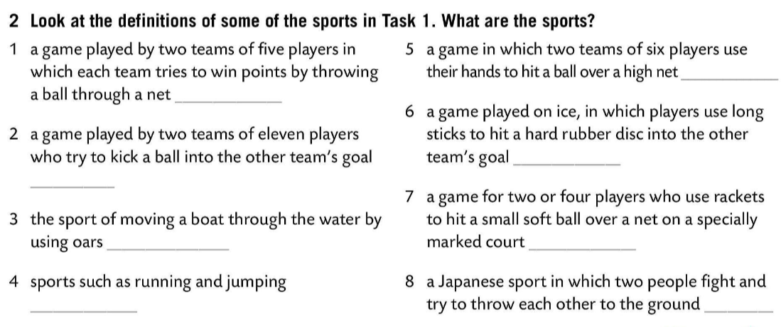
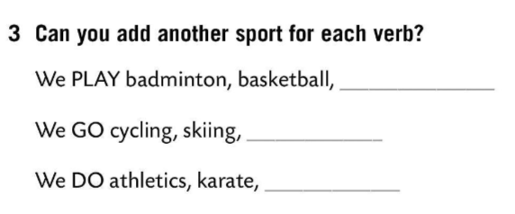
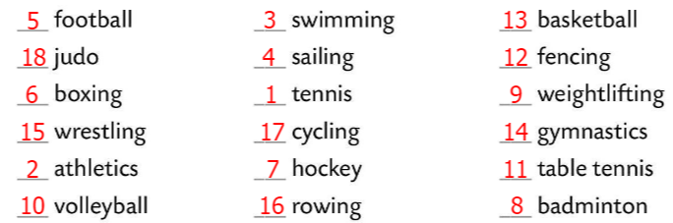
Here are some Olympic sports. Match the words in the box with the pictures.
volleyball
Check. Copy and translate.
basketball
football, volleyball, ice hockey, tennis, table tennis, handball, etc.
ice hockey
Look at the definitions of some of the sports in Task 1. What are the sports?
football
swimming, rowing, skating,surfing, etc.
rowing
tennis
judo, gymnastics, aerobics, etc.
athletics
judo
Check.
Can you add another sport for each verb?
Check.

Slide 4
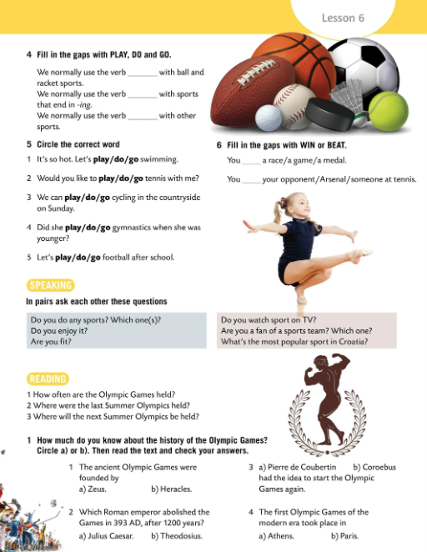
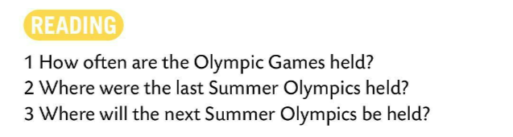
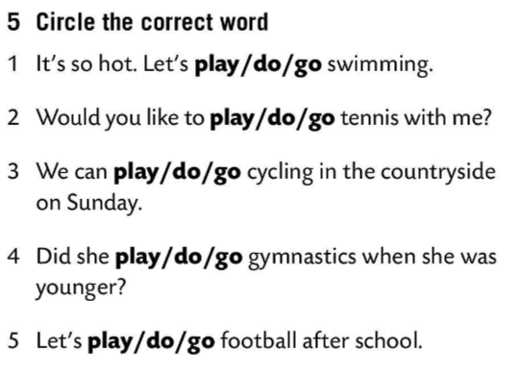
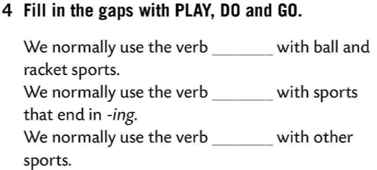

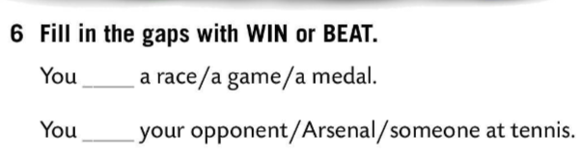
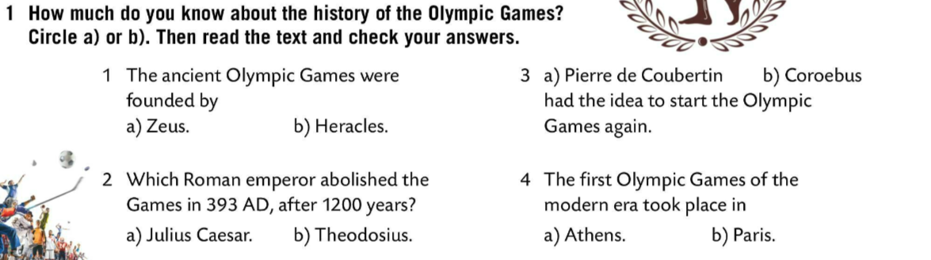
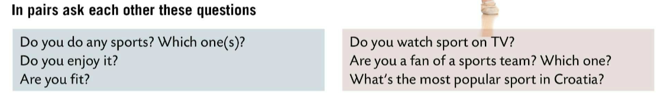

Fill in the gaps with PLAY, DO and GO.
Check.
Circle the correct word.
Check.
Fill in the gaps with WIN or BEAT.
Check.
Speaking time! In pairs ask each other these questions.
How much do you know about the history of the Olympic Games? Circle. Read the text and check your answers.

Slide 5
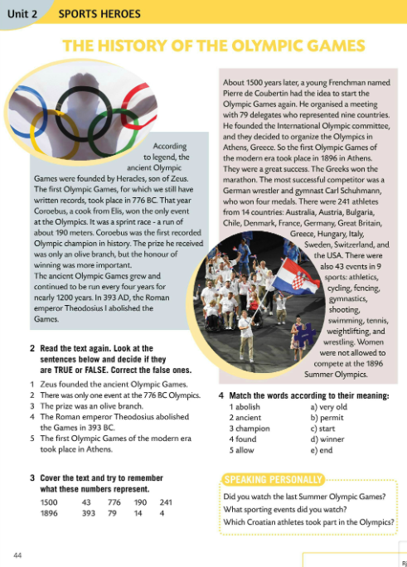
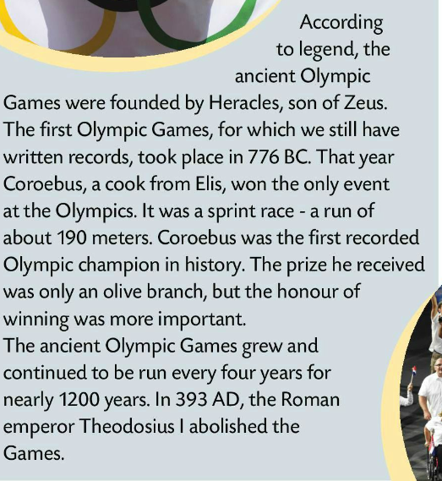
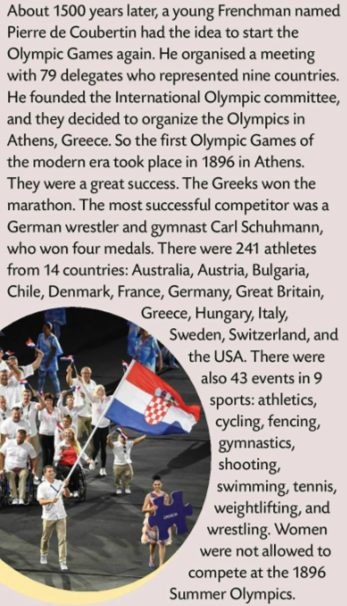
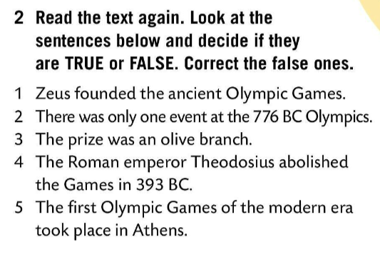
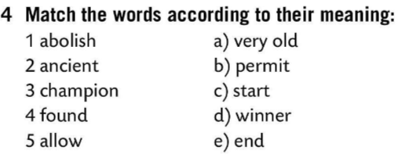
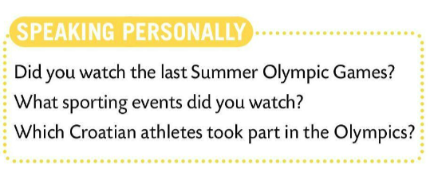
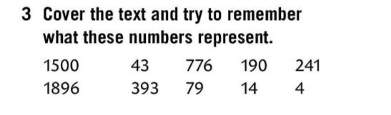
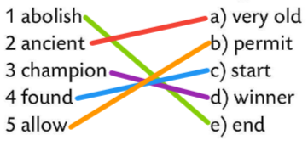
Read the text and check your answers.
Read again. Are the sentences true or false? Correct the false ones.
Check.
F
T
T
Match the words and their meaning.
T
Check.
T
Speaking time! Read the questions and share your answers with the class.

Slide 6
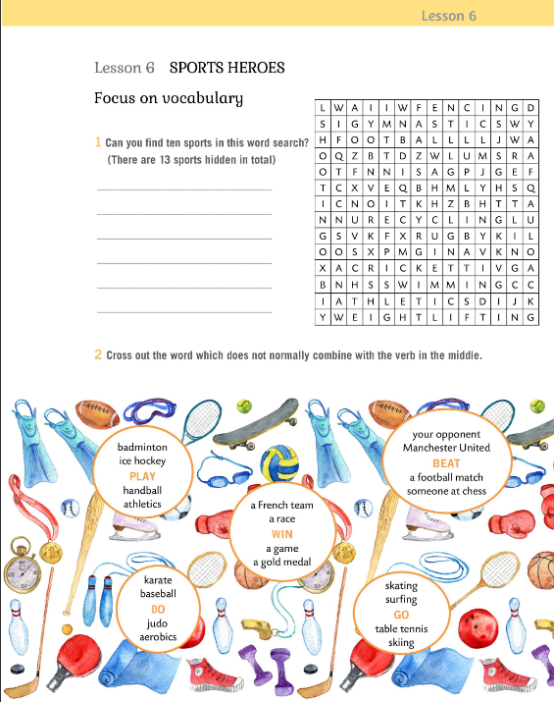

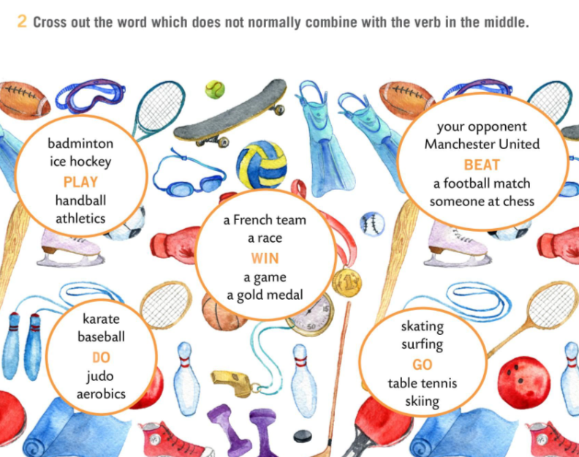
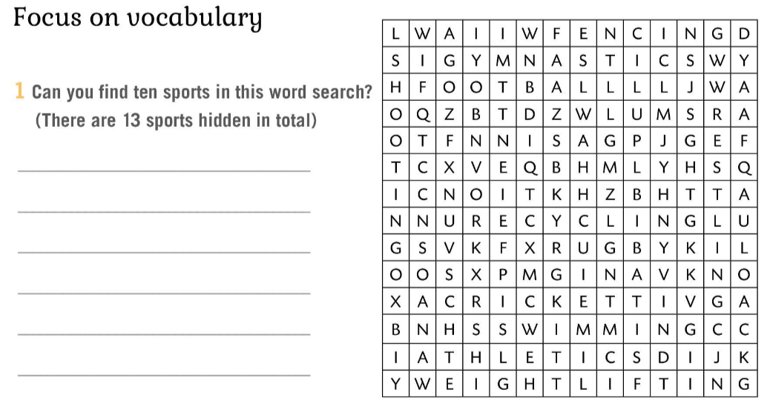
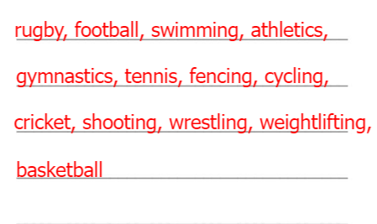
Workbook, p. 39
Can you find ten sports in this word search? (There are 13 sports hidden in total.)
Check.
Cross out the word which does not normally combine with the verb in the middle.
Check.

Slide 7
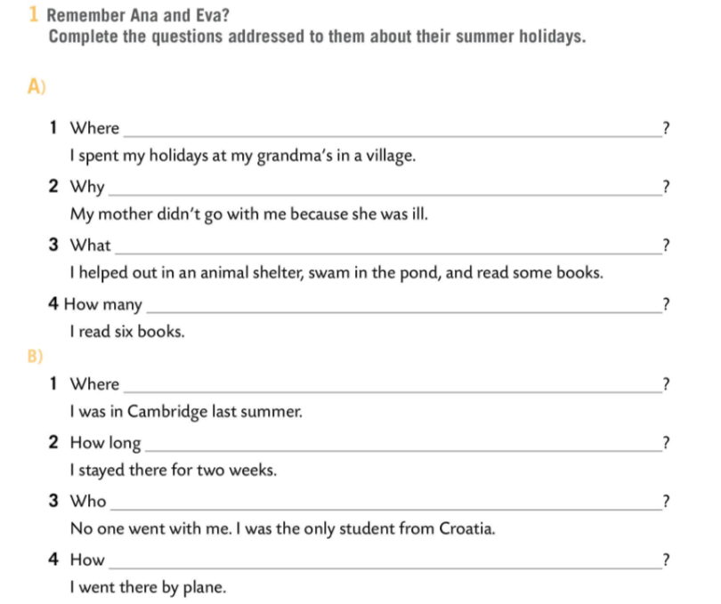
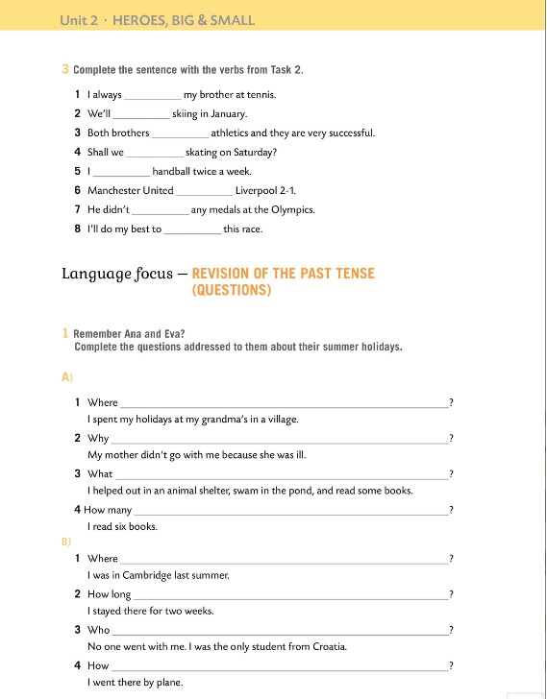
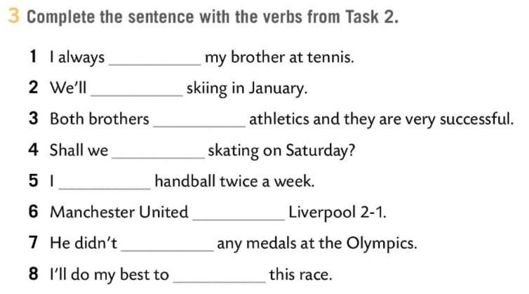
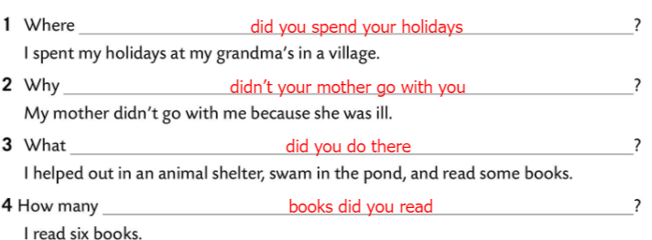
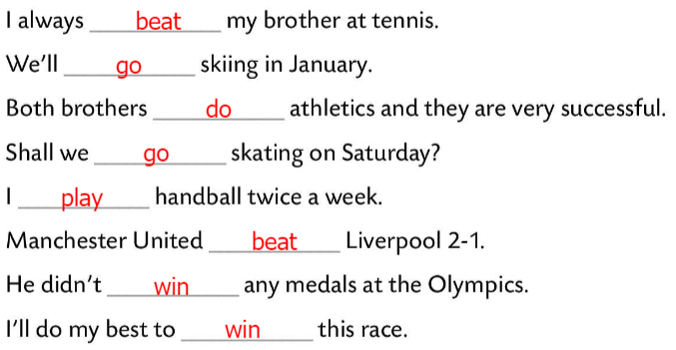
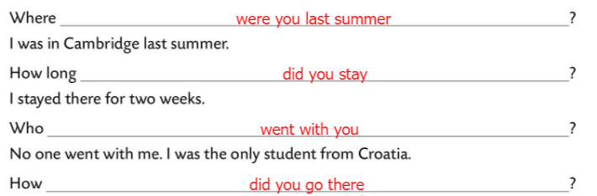
Workbook, p. 40
Complete the sentences with the verbs from Task 2.
Check.
Complete the questions addressed to Ana and Eva about their summer holidays.
Check.

Slide 8
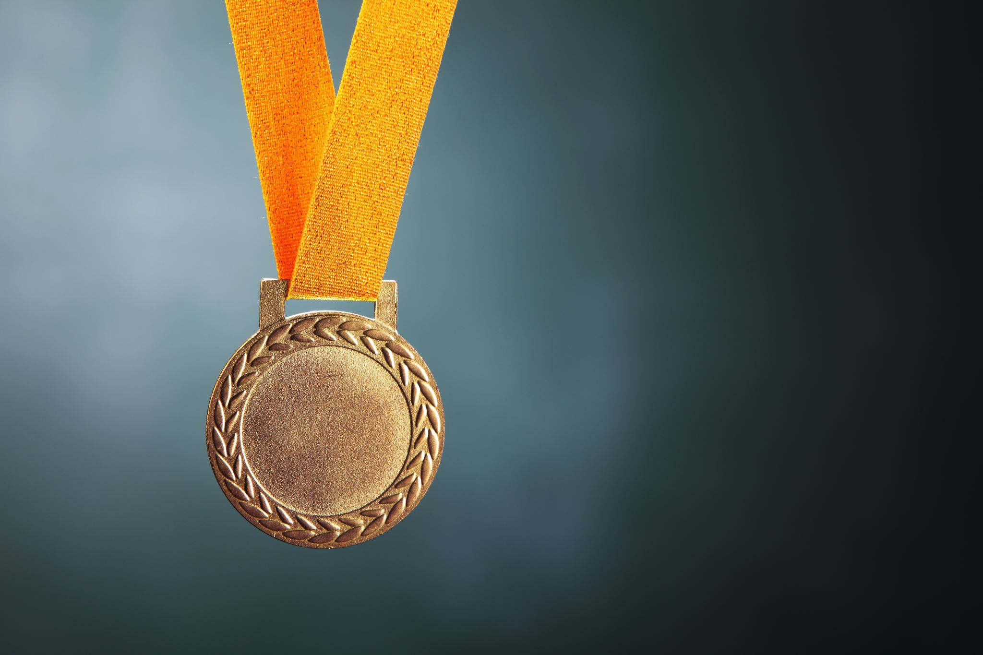
BRAINSTORM!
Pierre de Coubertin
4 years
J. Kostelić
THE OLYMPICS
Greece
summer
medals
winter

Slide 9
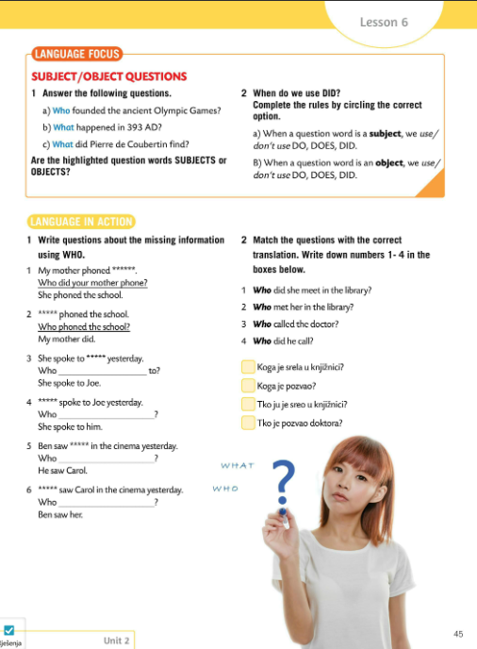
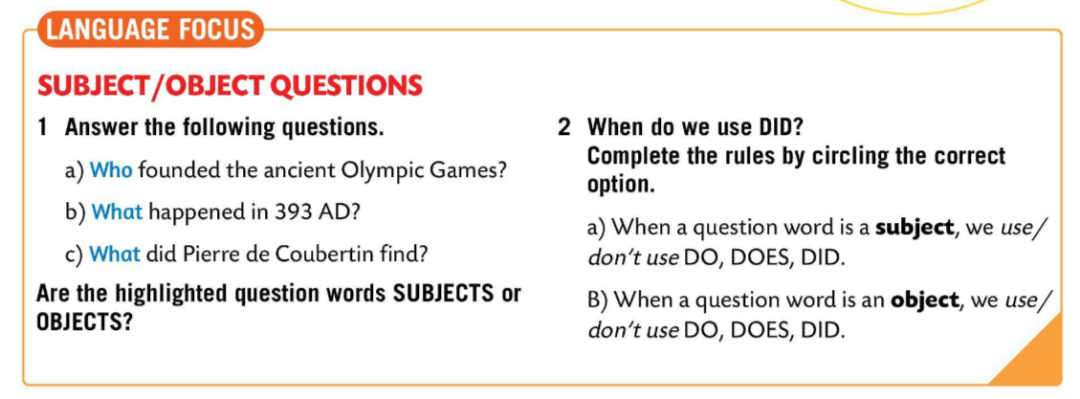
Answer the questions in the LANGUAGE FOCUS box.
Question words a) and b) are SUBJECTS.
Question word c) is an OBJECT.
Complete the rules by circling the correct option.
Check.
Copy the rules from Task 2.

Slide 10
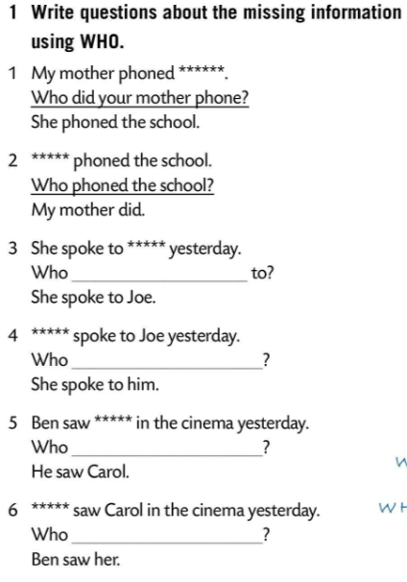
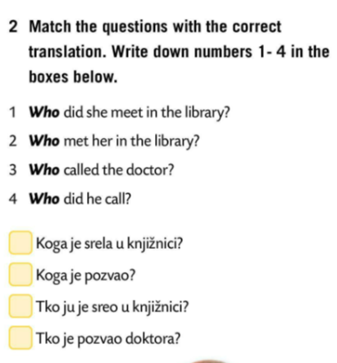
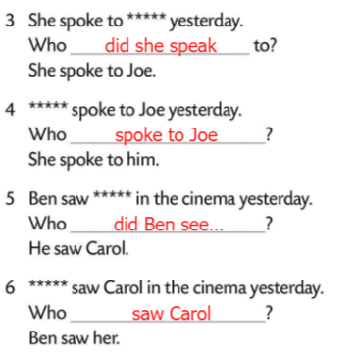

LANGUAGE BOX
Kada je upitna riječ SUBJEKT, ne koristimo pomoćne glagole DO, DOES, DID.
Who wanted more water?
Kada je upitna riječ OBJEKT, koristimo pomoćne glagole DO, DOES, DID.
Where did you go?
Write questions about the missing information using WHO.
Check.
Match the questions with the correct translation. Write down numbers 1-4 in the boxes below.
Check.

Slide 11
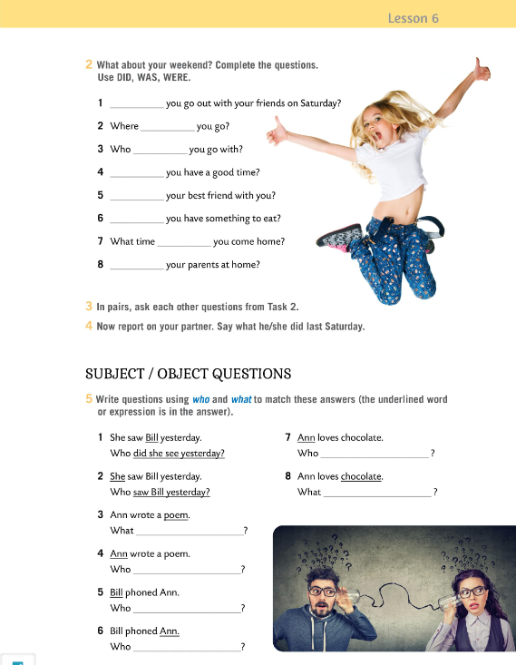
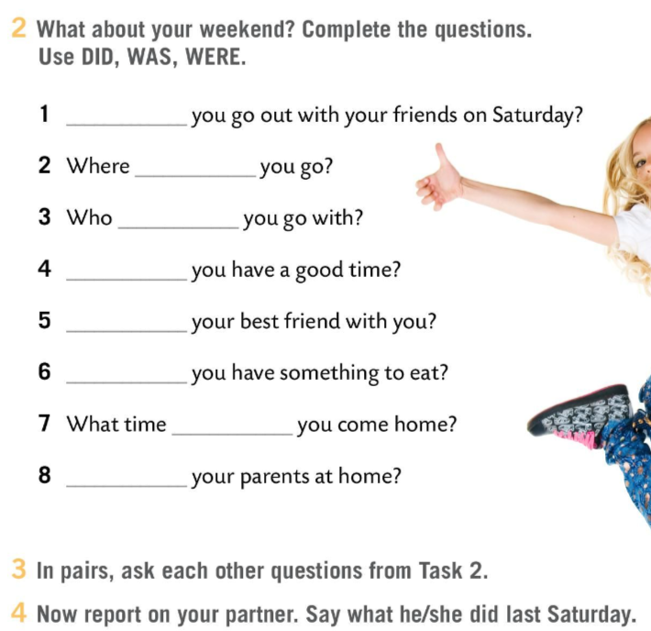
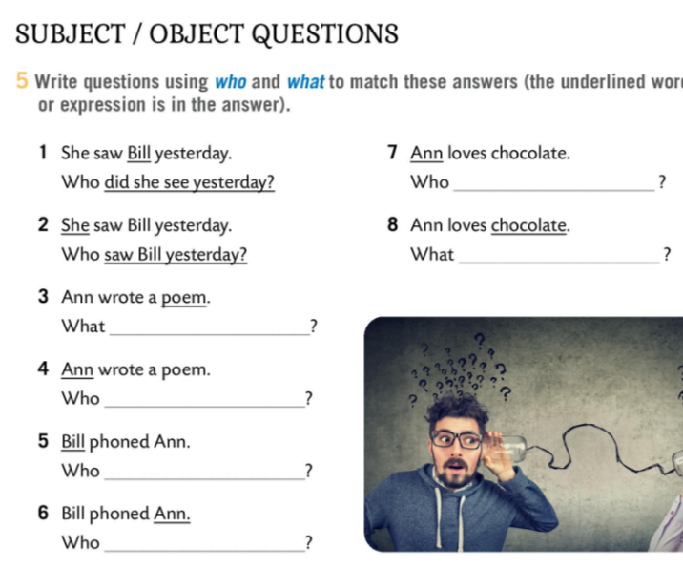
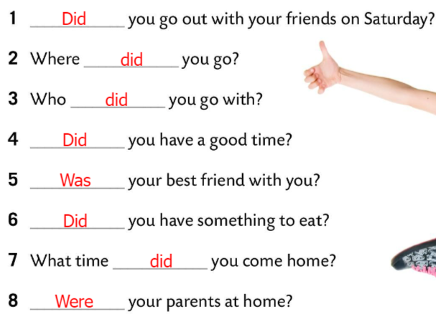
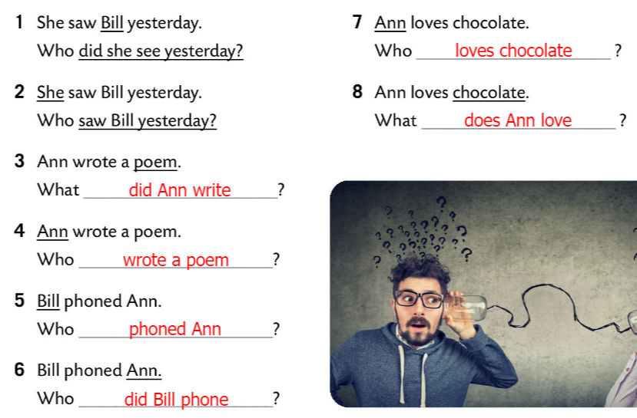
Workbook, p. 41
What about your weekend? Complete the questions. Use DID, WAS or WERE.
Check.
In pairs, ask each other questions from Task 2.
Report on your partner. Say what he/she did last Sunday.
Write questions using WHO and WHAT to match these answers (the underlined word or expression is in the answer.)
Check.

Slide 12
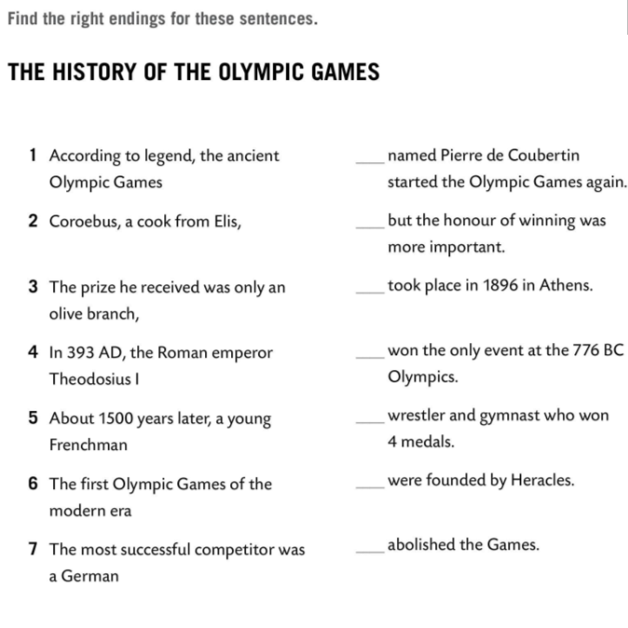
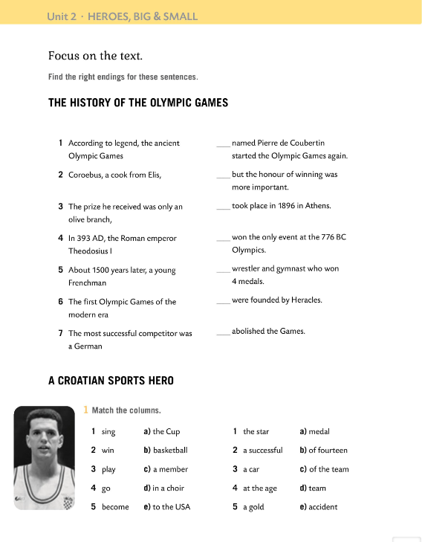
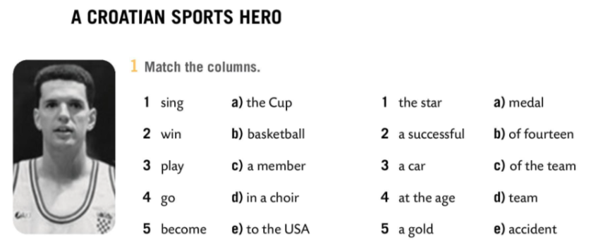
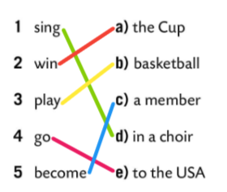
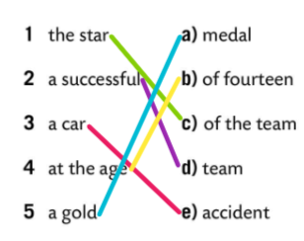
Workbook, p. 42
Find the right ending for the sentences in Task 1.
Check.
Match the columns.
Check.

Slide 13
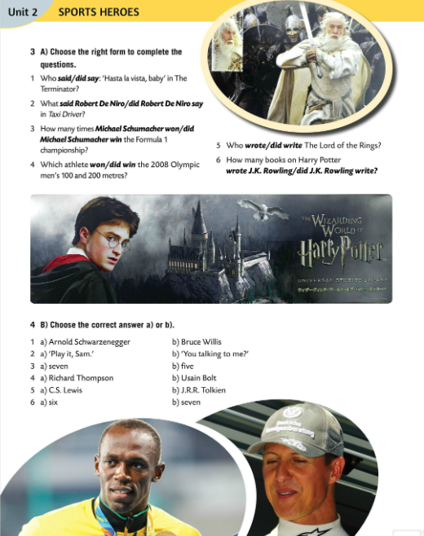
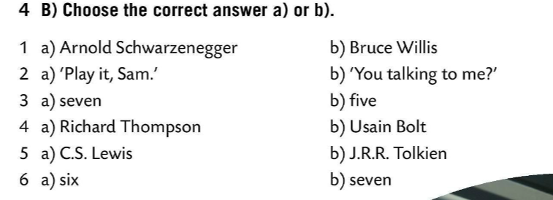
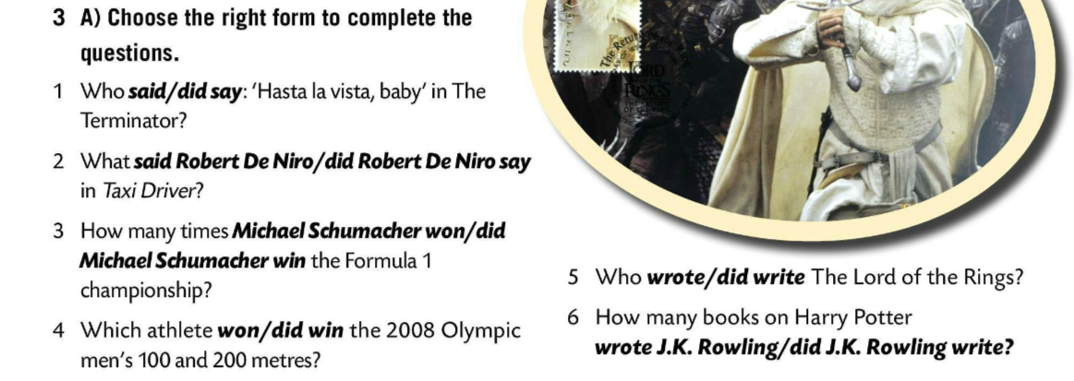
Complete the question. Choose the right form of the verb.
Check.
Answer the questions.
Check.
Sort out the sports in this online game.
https://wordwall.net/play/847/879/904

Slide 14
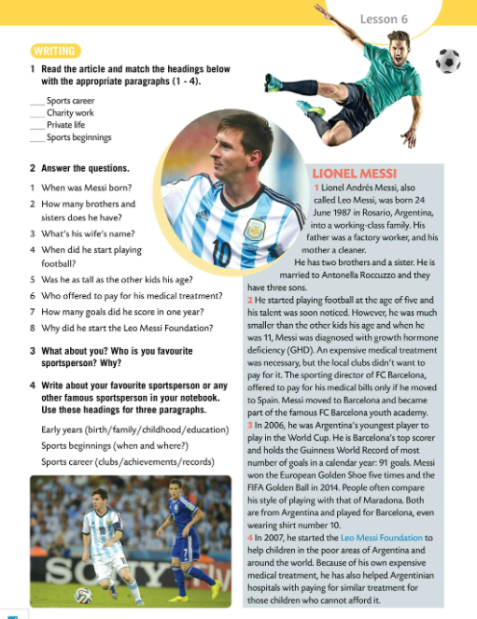




Read the article. Match the headings with the appropriate paragraphs (1-4).
Check.
Answer the questions.
Check.
1 He was born on 24th June 1987.
2 He has two brothers and a sister.
3 Her name is Antonella Roccuzzo.
4 He started playing football at the age of five.
5 He was much smaller than the other kids his age.
6 The sporting director of FC Barcelona offered to pay for his medical treatment.
7 He scored 91 goals in one year.
8 He started the foundation to help children in poor areas of Argentina and around the world.

Slide 15

What about you? Who is your favourite sportsperson? Why?
Write about your favourite sportsperson or any other famous sportsperson in your notebook. Use these headings for three paragraphs.
Play a game! ☺
https://wordwall.net/play/847/517/438

Slide 16






Workbook, p. 43
Fill in the missing words (the initial letters will help you.)
Check.
Divide the text into four paragraphs and write the appropriate heading for each paragraph.
Ask questions about Dražen Petrović. Use what, where, when, how.
Check.

